Slide 2
SOCCOM: Unlocking the Mysteries of the Southern Ocean
Southern Ocean Carbon and Climate Observations and Modeling
Notes:
The Southern Ocean Carbon and Climate Observations and Modeling project (SOCCOM) is an NSF-sponsored program focused on unlocking the mysteries of the Southern Ocean and determining its influence on the climate.

Slide 3
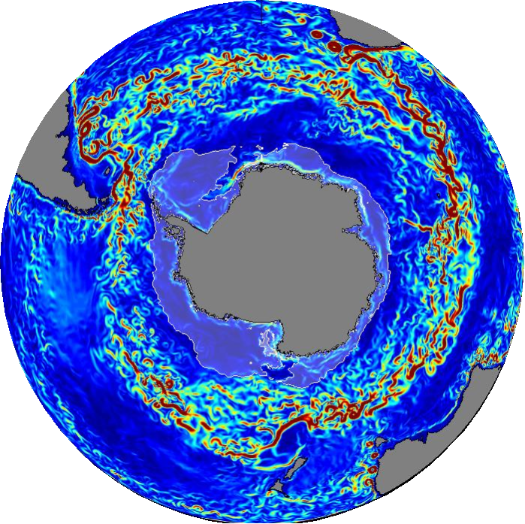
What’s so special about the Southern Ocean?
Notes:
Why do we care about the Southern Ocean?

Slide 4
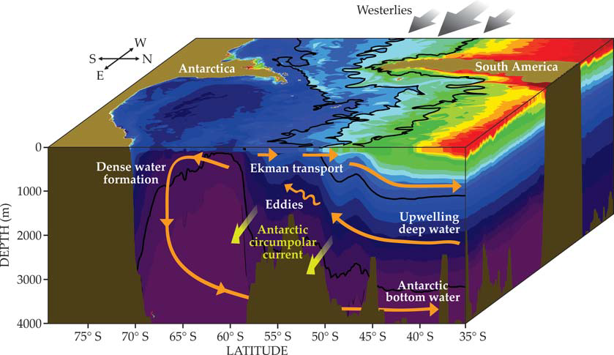
Upwelling
1
Morrison et al. (Physics Today, 2015)
Notes:
The Southern Ocean is the place where some very important dynamics take place that affect the rest of the world’s oceans.
The Southern Ocean is the only place in the world where deep water, which has sunk to the depths of the oceans in other parts of the world, upwells to the surface. This happens because the westerly winds in the Southern hemisphere push surface water open, allowing deep water to upwell. The upwelling has huge impacts on the Earth’s atmosphere and climate.
This deep water that comes to the surface in the Southern Ocean is cold, and easily absorbs heat from the atmosphere, and it is also rich in nutrients, providing the food source for ¾ of the biological production in the rest of the oceans. Because the upwelled water refreshes the surface water, it can continually absorb far more carbon from the atmosphere.

Slide 5
Heat Absorption
2
IPCC AR5 (2013) WGI Chapter 3 (ocean observations), IPCC AR5, Fig. 3.3
Notes:
If the excess heat in the system that is now in the ocean were in the atmosphere, surface air temperatures would be 100°C warmer.
The majority of heat absorption (93%) from the atmosphere by the Earth takes place in the ocean, and the Southern Ocean accounts for 67-98% of the excess heat that is transferred from the atmosphere into the ocean each year.
As the global ocean warms and in particular the Southern Ocean, the ecology of the Southern Ocean changes. Scientists would like to be able to know that heat transfer takes place and how it will change in the future as the Earth continues to warm.

Slide 6
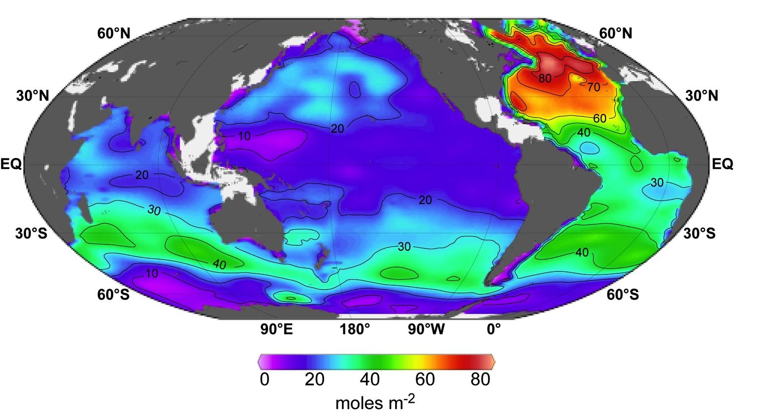
Carbon Absorption
3
Feely and Sabine, http://www.pmel.noaa.gov/co2/PressConference.html
Notes:
High inventories are associated with deep water formation in the North Atlantic and intermediate and mode water formation between 30°S and 50°S.
Globally, the oceans absorb about ¼ of emissions by human activities such as burning fossil fuels, reducing the speed of climate change. About 43% of this occurs in the Southern Ocean.
Carbon absorption in the Southern Ocean has a limit. As humans continue activities that increase the amount of CO2 in the atmosphere and consequently the oceans, the oceans reach

Slide 7
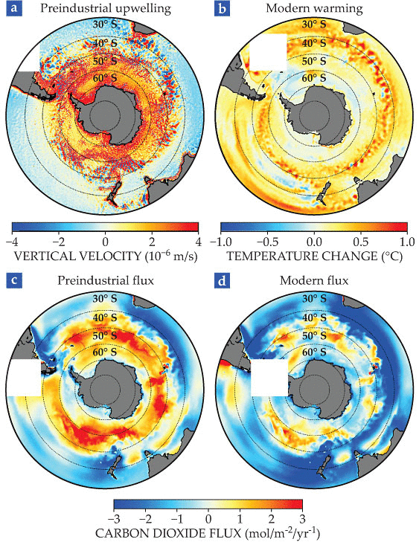
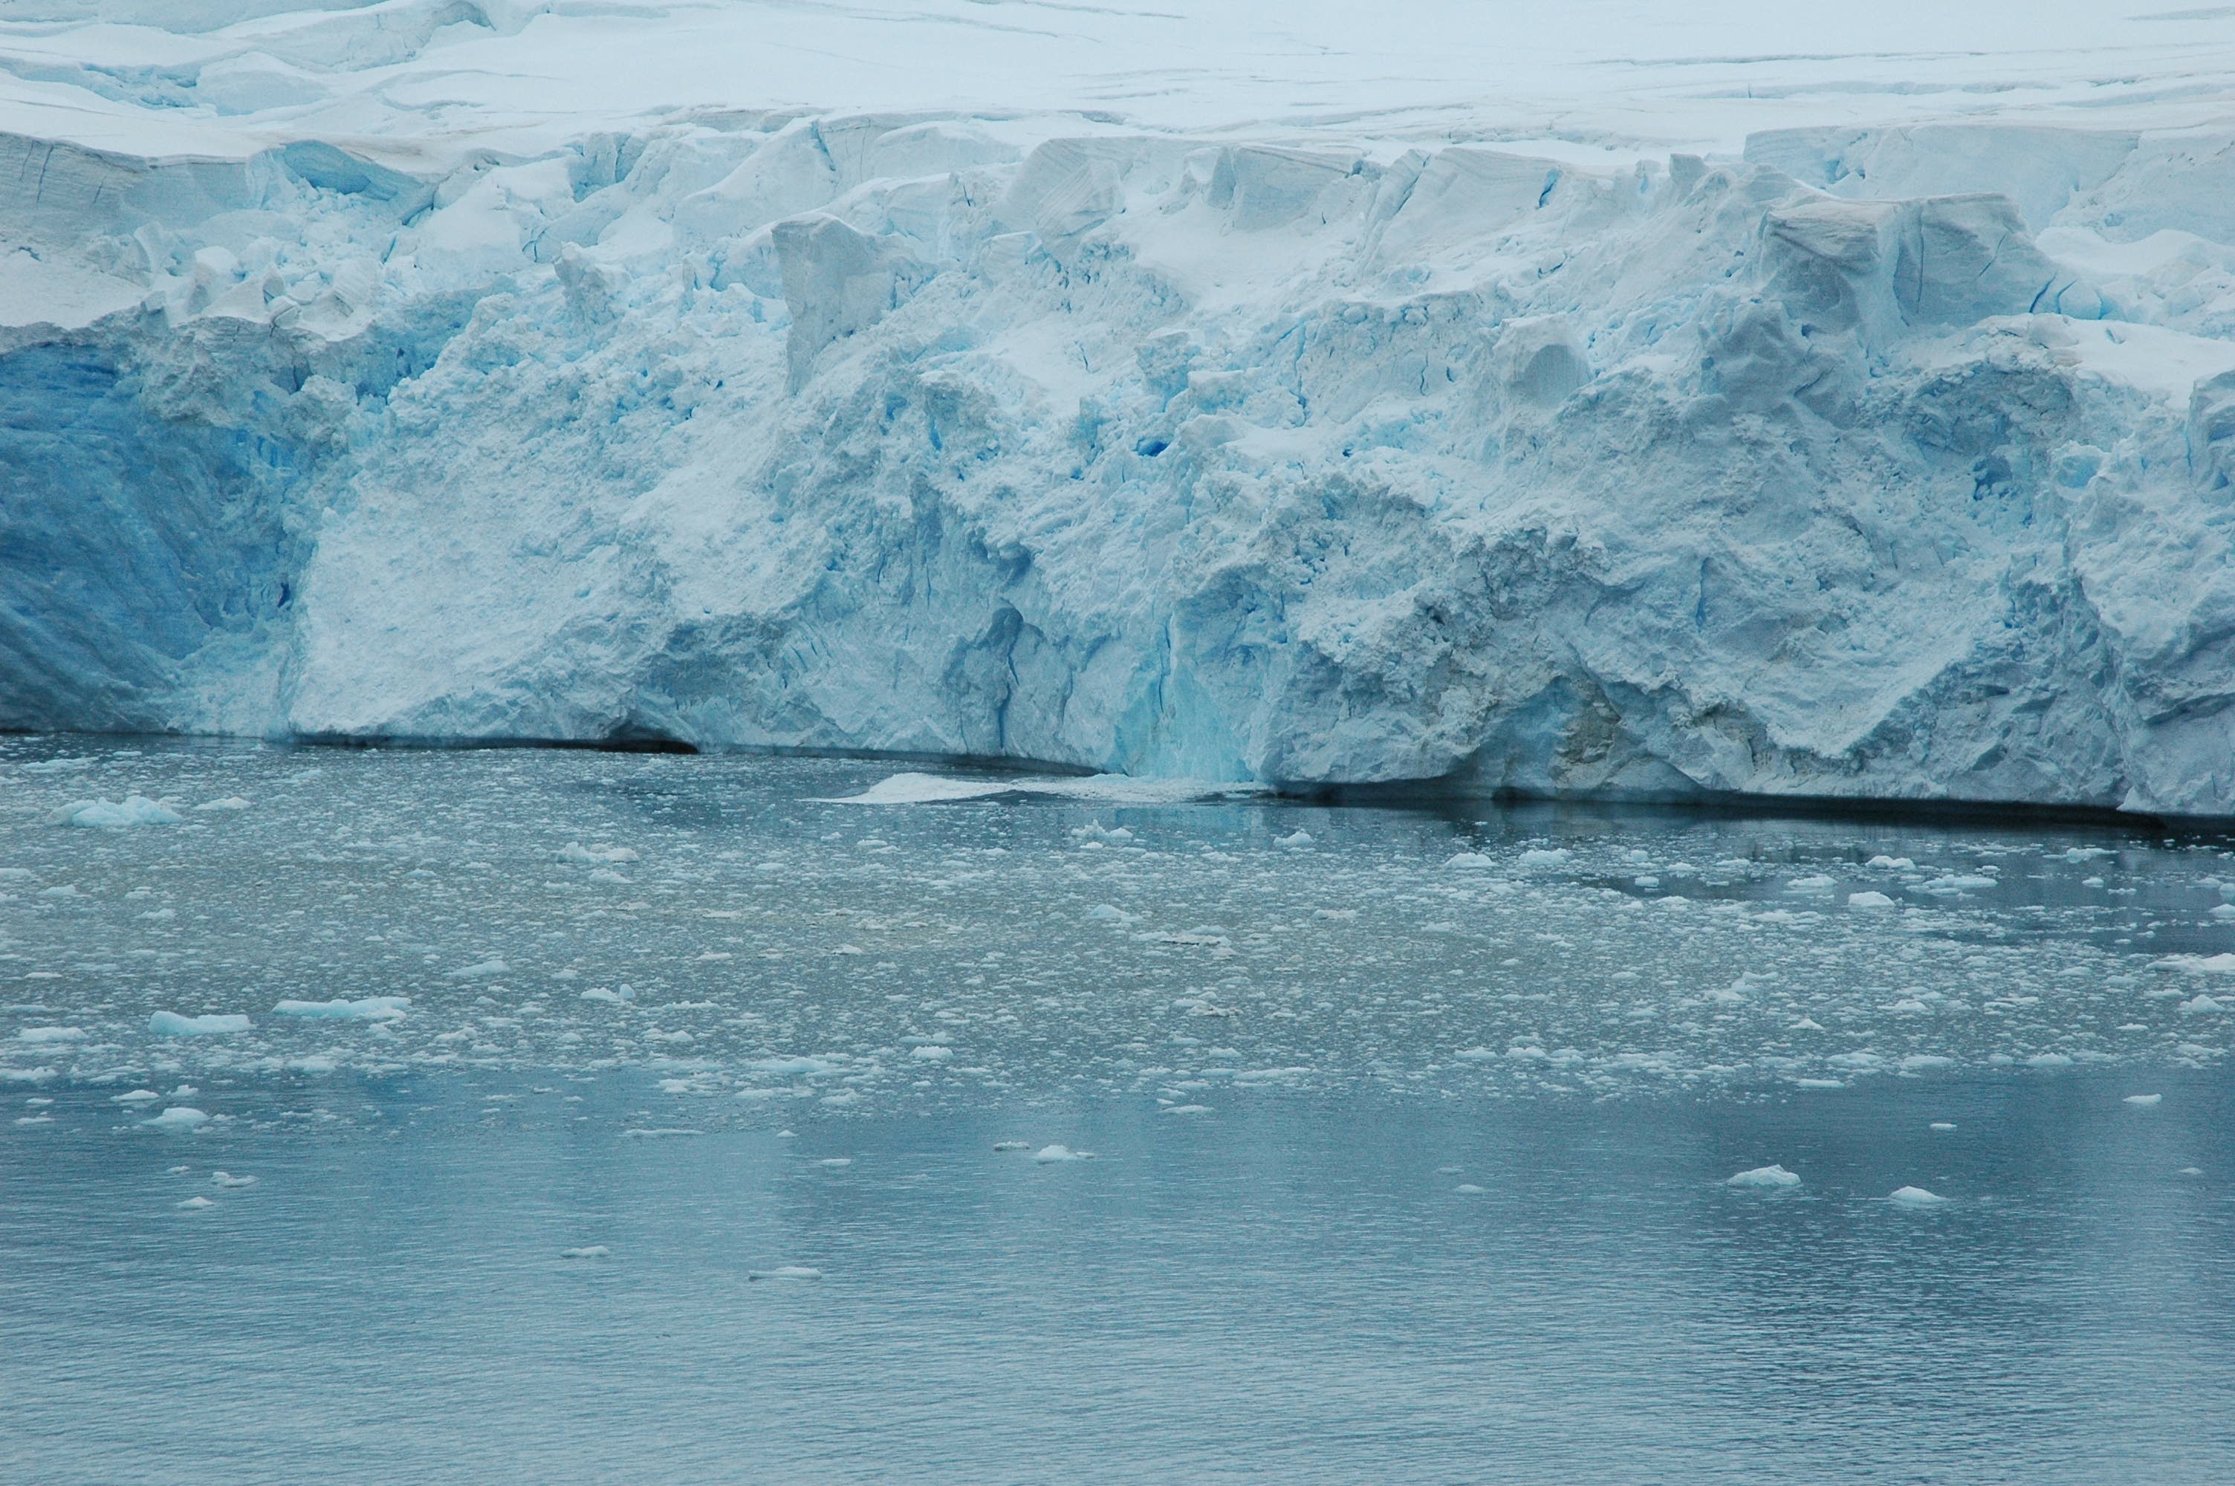
Relationship between the Southern Ocean and our Climate
Morrison et al 2015, Oscar Schofield 2013
Notes:
The Southern Ocean has been key in mediating climate change, keeping our atmosphere from becoming too carbon-concentrated and too hot.
However, it is also an area of concern as climate projections forecast more anthropogenic carbon dioxide and heat in the atmosphere. The question is—how will the Southern Ocean react to these higher levels. Will there be a stagnation in how much heat or CO2 the S.O. can take up as it continues to absorb more than it expels.
In the graphic above, which is based on a high resolution climate model, (a) depicts the vertical component of velocity averaged over the upper 200 m of the ocean. Upwelling is positive (red) and downwelling is negative (blue). (b) Ocean warming averaged over the top 1 km when the concentration of atmospheric carbon dioxide is 400 ppm and assumed to increase at 1% every year since preindustrial times. (c) and (d) are air-sea fluxes of CO2 in preindustrial and post-400 ppm times respectively. Positive fluxes (red) indicate the outgassing of CO2 from the ocean to the atmosphere, and the negative fluxes (blue) indicate carbon uptake by CO2.
As the Southern Ocean is forced to absorb more and more CO2, we risk reaching an upper limit on how much the system can absorb. The Southern Ocean may decrease in efficiency of taking up CO2—or it may not.
The consequence of this reduced CO2 uptake would be a higher level of atmospheric CO2 on multi-century time scales. The Southern Ocean may also become more stratified, which would reduce the vertical mixing and consequently the upward flux of natural CO2 and the downward flux of anthropogenic CO2 (Sarmiento et al 1998). It would be helpful to understand the impact of stratification on the Southern Ocean’s uptake of CO2.

Slide 8
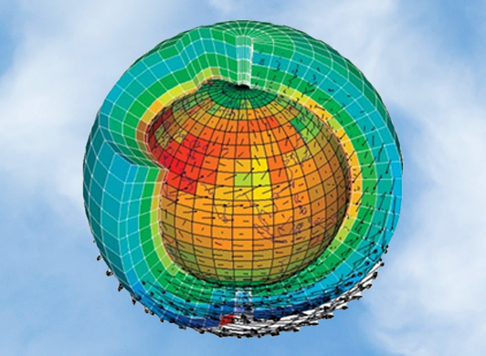
What does SOCCOM seek to do?
Observations
+
Models
Isa Rosso, R/V Palmer Cruise 2014; ETH Zürich, Carbones EU Project
Notes:
SOCCOM seeks to learn more about the Southern Ocean’s role in climate by taking measurements (using innovative new tools), building models, and then blending the two to inform one another.
(Here’s a picture of a SOCCOM float being deployed, and here’s a cartoon of a global climate model)

Slide 9
Observations from Floats
will open our eyes…
CM2.6, R Slater
Notes:
Animation of Southern Ocean Nitrate—this animation is meant to show the unprecedented amount of data the floats will gain over the course of the SOCCOM program.
Modeled and observed CM2.6. Nitrate as background with observations overlaid—Potential projected BGC-Argo through SOCCOM; Courtesy of R. Slater
This animation shows the observed climatological monthly nitrate data (from the World Ocean Atlas). Ship tracks between 1983 and 2008 that made hydrographic and nutrient measurements are overlaid in purple squares in the month they were taken, and are then replaced by black or white squares depending on the season (white for summer, black for winter). Ship tracks remain for 10 years after the cruise data. Starting in the animation’s year 2010, data taken by the Argo array are indicated by triangles, color-coded with the same convention. Argo data is delayed in this animation by eight calendar years (data collected in 2005 will appear in the year 2013 in the animation) in order to avoid significant overlap with the ship-based data.
The new SOCCOM floats are a new generation of the Argo floats (which measure temperature and salinity in the global oceans). They are equipped with a suite of biogeochemical sensors, which measure dissolved oxygen, nitrate, pH, in addition to chlorophyll fluorescence, backscatter, light transmission (or light intensity). They are designed to give us an idea of how carbon and heat are being transferred between the ocean and the atmosphere.
Currently a key problem with our knowledge of the Southern Ocean is simply how under-sampled it is. As soon as we collect enough data to understand the status quo, we will be able to make estimates about what will happen in the future.

Slide 10
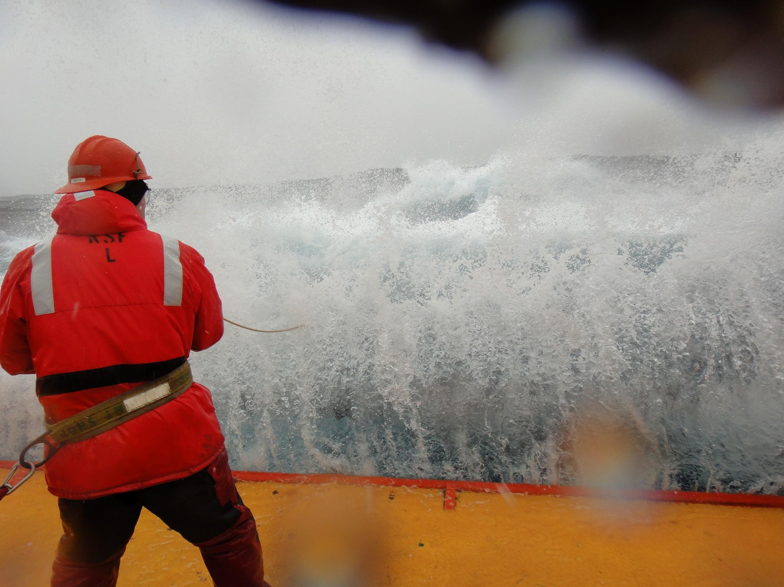
Notes:
Why is the Southern Ocean so under-sampled?
The conditions are extremely harsh and hazardous. Waves in the Southern Ocean are enormous (Roaring 40s, Furious 50s, Shrieking 60s) because the winds blow around the entire globe unimpeded by any land mass; icebergs may form at any time of year throughout the ocean, and the remoteness makes the region out of reach of search and rescue.
Because of these hazards, we know less about the Southern Ocean than we do about the surface of Mars. Observations that do exist from the Southern Ocean come from research cruises, which cover very specific areas of the ocean, and can only be taken one at a time during one part of the year—austral summer.

Slide 11
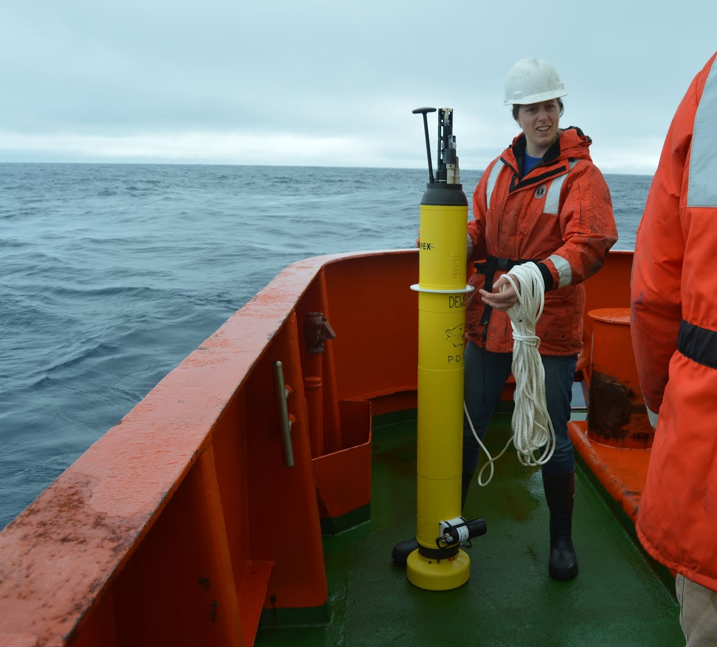
What’s a Float?
pH
Sensor
Nitrate
Sensor
Oxygen
Sensor
Notes:
“Biogeochemical” Float – a float that collects data on parameters including temperature, pressure, pH, nitrate, oxygen, backscatter, and salinity.
The first of SOCCOM’s objectives is to develop a new observing system for carbon, nutrients, and oxygen that will complement and expand on the existing observing system for heat and freshwater, and that is capable of providing sustained observations with seasonal resolution throughout the Southern Ocean and beyond the five to ten years that NSF might support the Center.
It will accomplish this task by deploying floats. Once deployed from the ship, these floats take continual measurements over the course of 5-6 years. The floats spend 10 days floating at a depth of 1000 meters (both to conserve energy—no need to collect data more than every 10 days) and to avoid icebergs. After floating under water for 10 days, the floats sink to a depth of 2000 using a buoyancy bladder.
The float travels up towards the surface after sinking to 2000 meters. On its way up, it samples the ocean water at different depths, gathering data using optical sensors. As the float nears the surface, it takes continual temperature measurements, and if the water temperature nears the freezing point, the float will stop rising—sensing the presence of icebergs. It will return to its parking depth of 1000 meters. If the temperature is above freezing, it will rise all the way to the surface and relay its data via satellite to the lab. This way, scientists will continue to receive more and more data. As the floats explore the Southern Ocean.

Slide 12
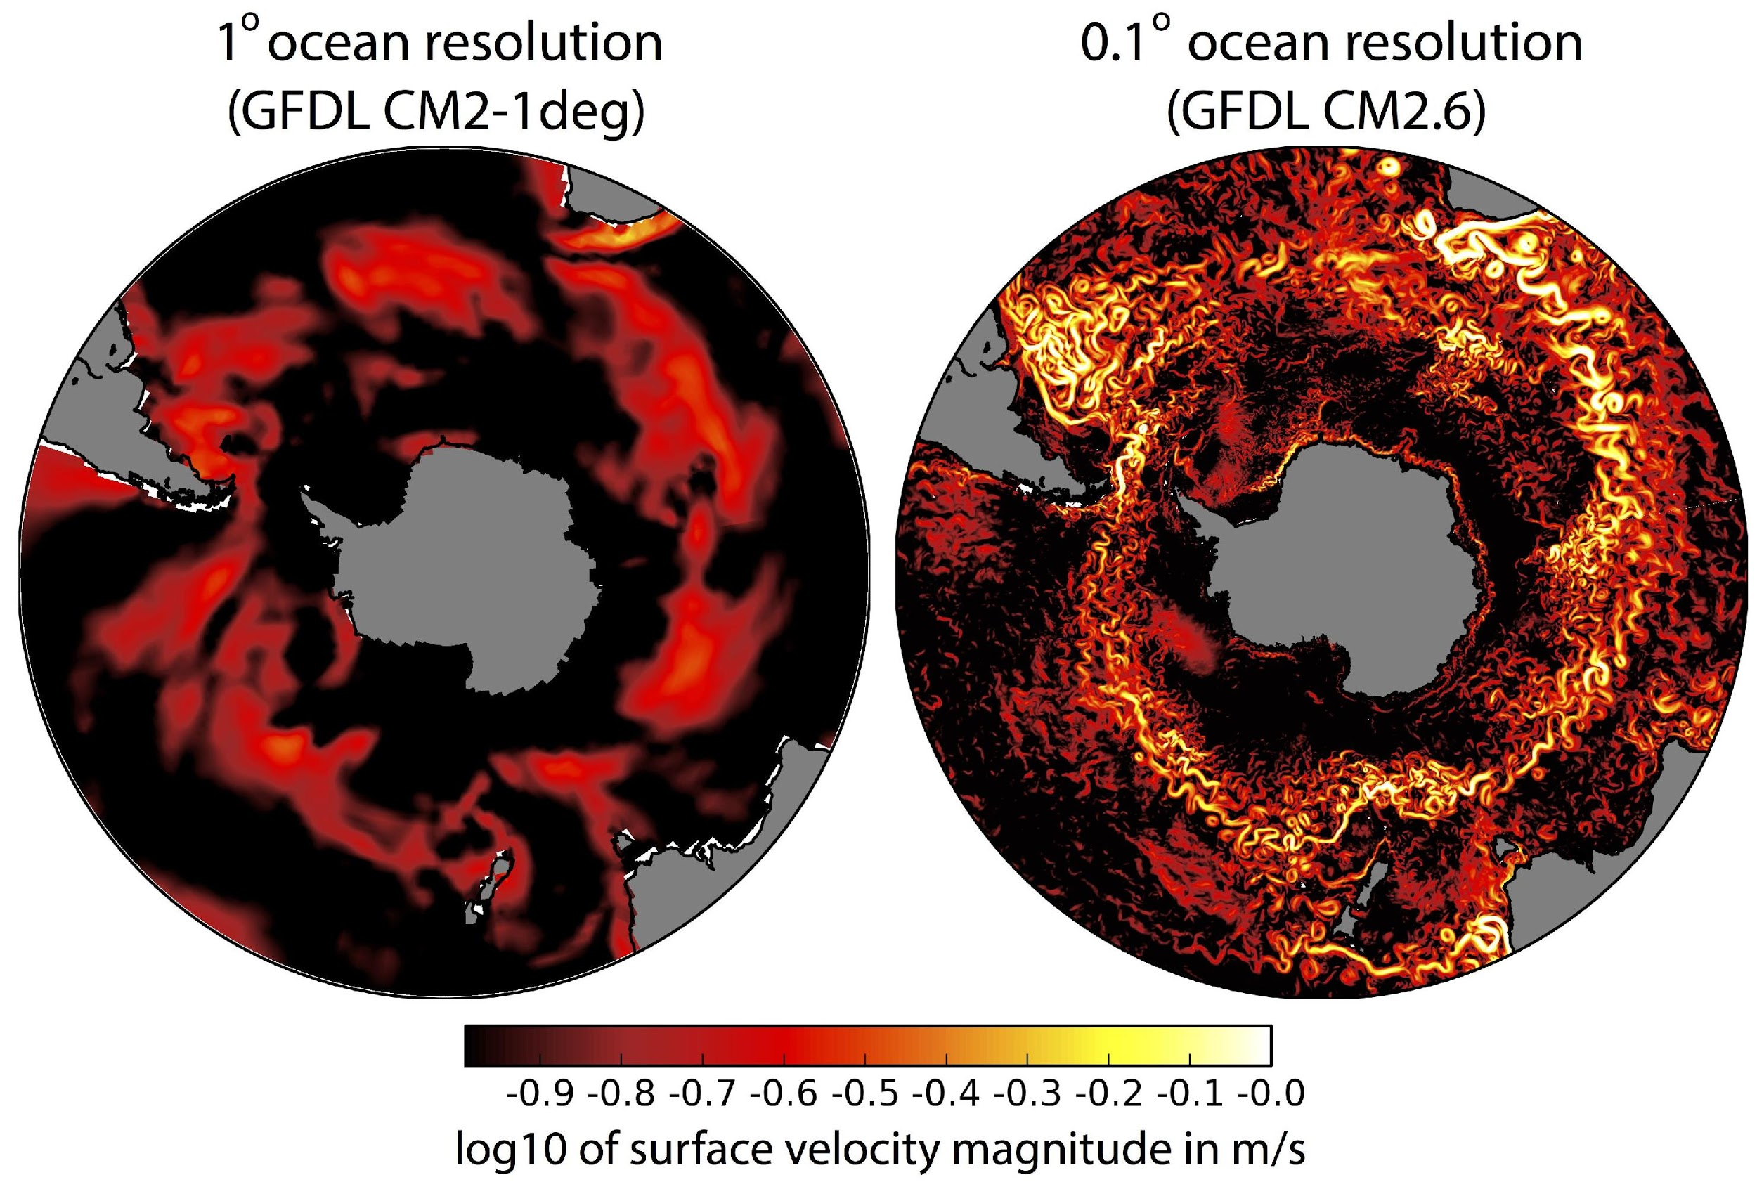
Models from Supercomputers and Assessment Algorithms
Feely and Sabine, http://www.pmel.noaa.gov/co2/PressConference.html
Notes:
In addition to building floats and collecting measurements, SOCCOM is using these measurements to estimate the
Specific Goals for Modeling:
1. Create a new 3D estimate that will map the Southern Ocean’s biogeochemistry over time including how carbon and heat are transferred between the air and the water and the cycling of nutrients. These models will be built using data from “physical observations”, the floats, and a new generation of eddy permitting eddy resolving ocean circulation models.
2. Build tools for assessing the model simulations and project the role of winds and layering in affecting the impacts of warming on the ocean’s role in the climate.
3. Interact with the broader climate modeling community by developing a protocol for international model intercomparison (SOMIP) and encouraging the use of the new assessment tools, leading to a more collaborative and focused modeling community, able to simulate the Southern Ocean’s role in climate and biogeochemical cycles.
4. Develop improved parameterizations for the next generation of climate models

Slide 13
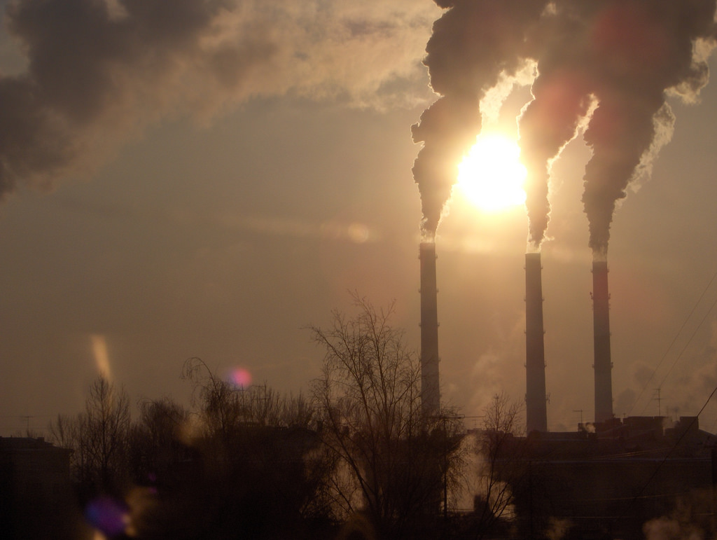
What do models tell us?
otodo / Flickr
Notes:
Where we’re headed…Climate Change
When we burn fossil fuels, we pump CO2 and other greenhouse gases into the atmosphere. Those emission perpetuate climate change, making our atmosphere and ocean more concentrated with carbon and hotter.
It’s not clear how long it will take before we decrease our emissions and it’s not clear by how much, so it isn’t clear what our atmosphere will look like in 25, 50, 100 years.
However, by looking at the status quo and try to understand how carbon interacts with the surface with the ocean. The rate of carbon and heat absorption in the Southern Ocean and its physical dynamics will tell scientists how susceptible the oceans will be to further emissions and consequently give us some indication of the fate of the Earth’s atmosphere and estimates for land absorption of heat and CO2.
Understanding the Southern Ocean will allow us to understand our climate and how it will change in the future.

Slide 14
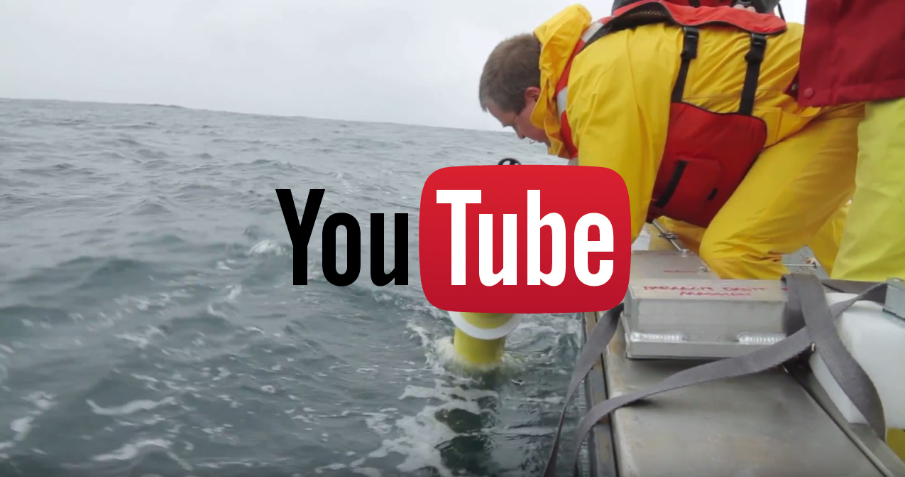
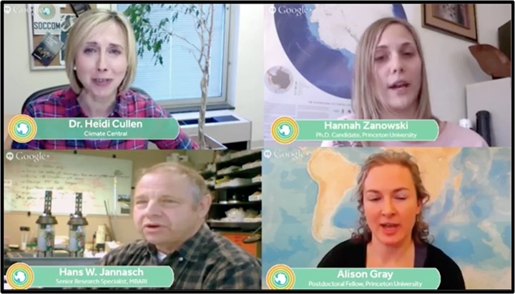
Resources
.princeton.edu
soccom.princeton.edu
Notes:
Flickr: https://www.flickr.com/photos/139764369@N07/albums (SOCCOM Project)
Instagram: @soccomproject
Twitter: https://twitter.com/SOCCOMProject
Facebook: https://www.facebook.com/soccom.princeton/?fref=ts
YouTube: https://www.youtube.com/channel/UCitgNcM528kXbi-6x2hQBKQ
SOCCOM website: soccom.princeton.edu
Climate Central Page: http://www.climatecentral.org/what-we-do/our-programs/soccom
Video modules pages: Google Drive

